Slide 1
Table of contents
01
02
03
Classifications with artificial data
Explore BERT
Classifications with real data

Slide 2
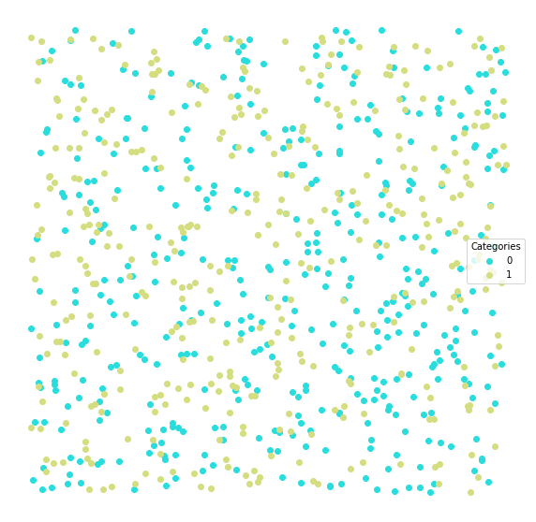
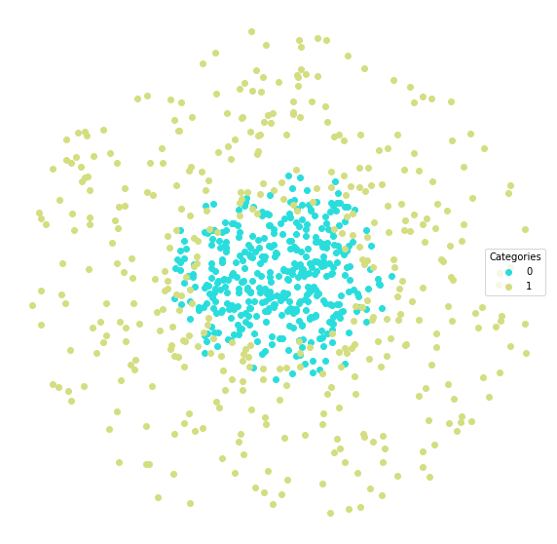
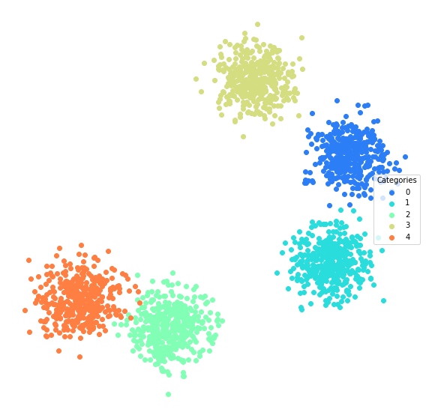
Artificial datasets
10 datasets from 5 different random functions.
8 classifiers: Naïve Bayes, Support Vector Machine, K Nearest Neighbor, Logistic Regression, Decision Tree, Random Forest, Neural Network, and Gradient Boosting

Slide 3
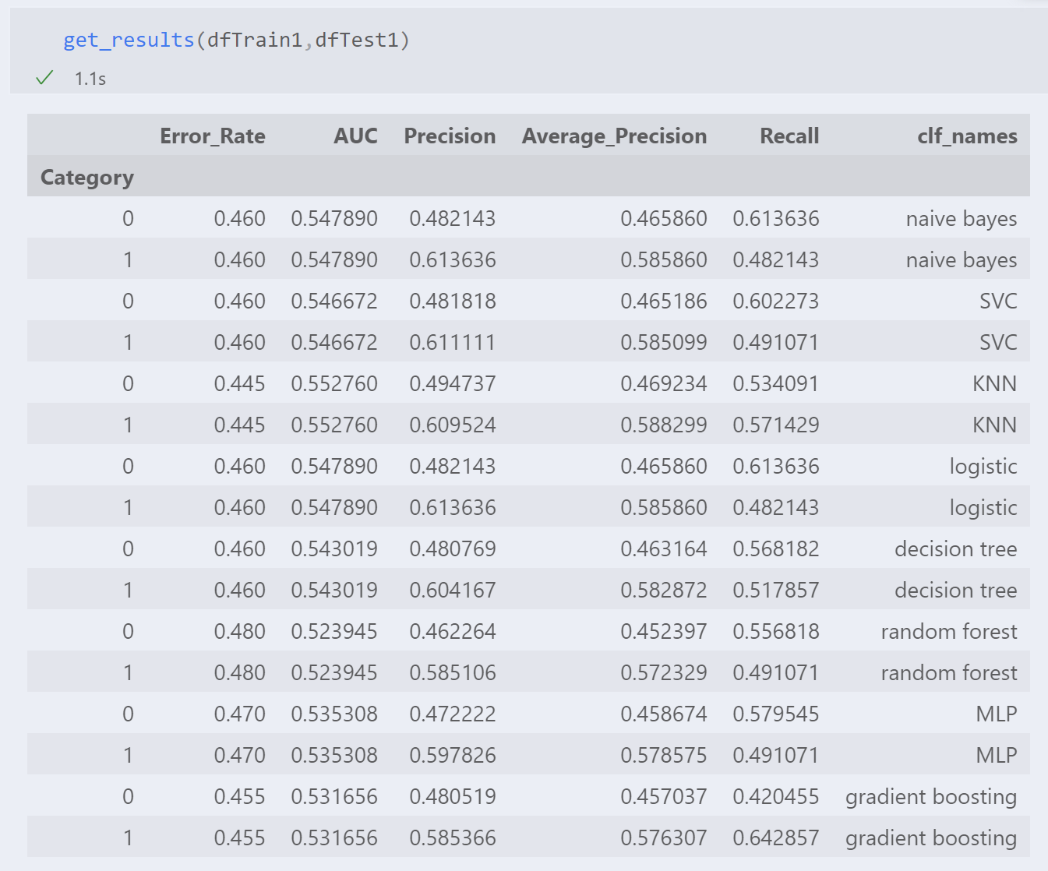
Classifying complete mess
Each two rows is the performance of the classifier shown on the right column.

Slide 4
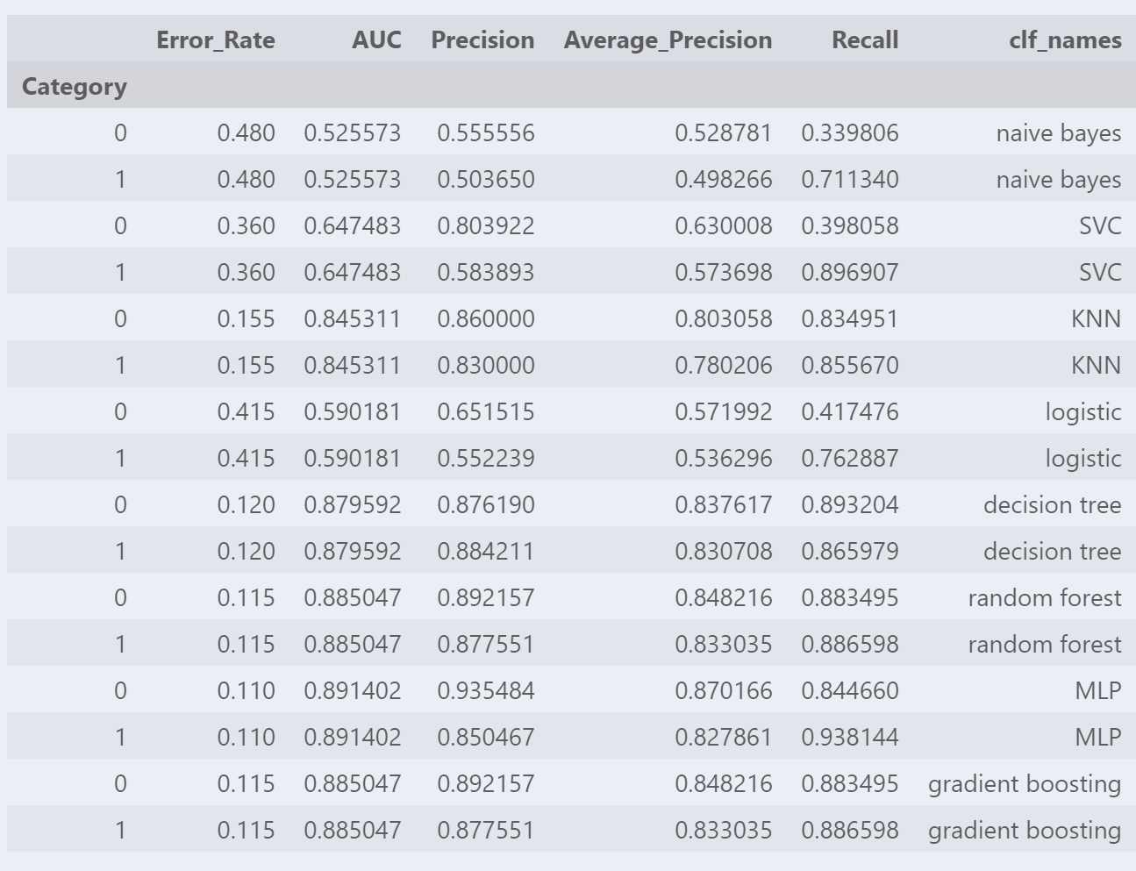
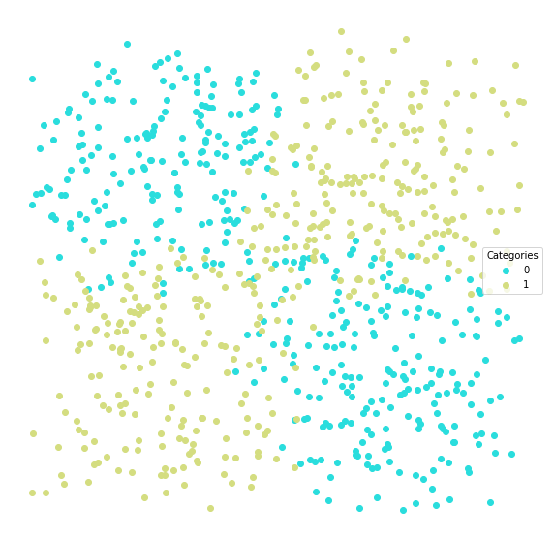
Medium difficulty
Each two rows is the performance of the classifier shown on the right column.

Slide 5
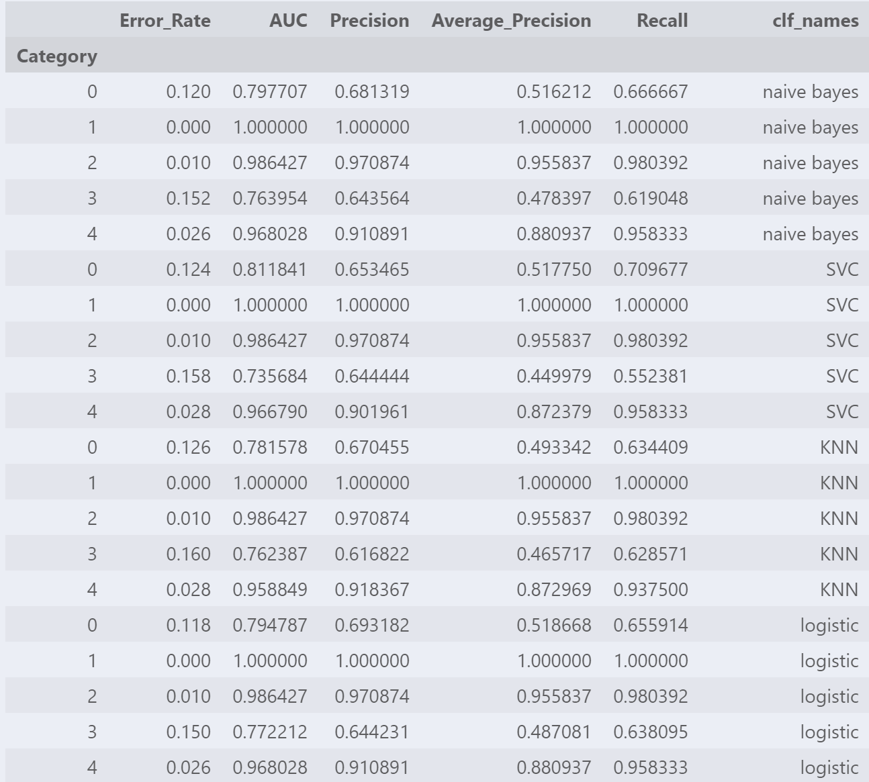
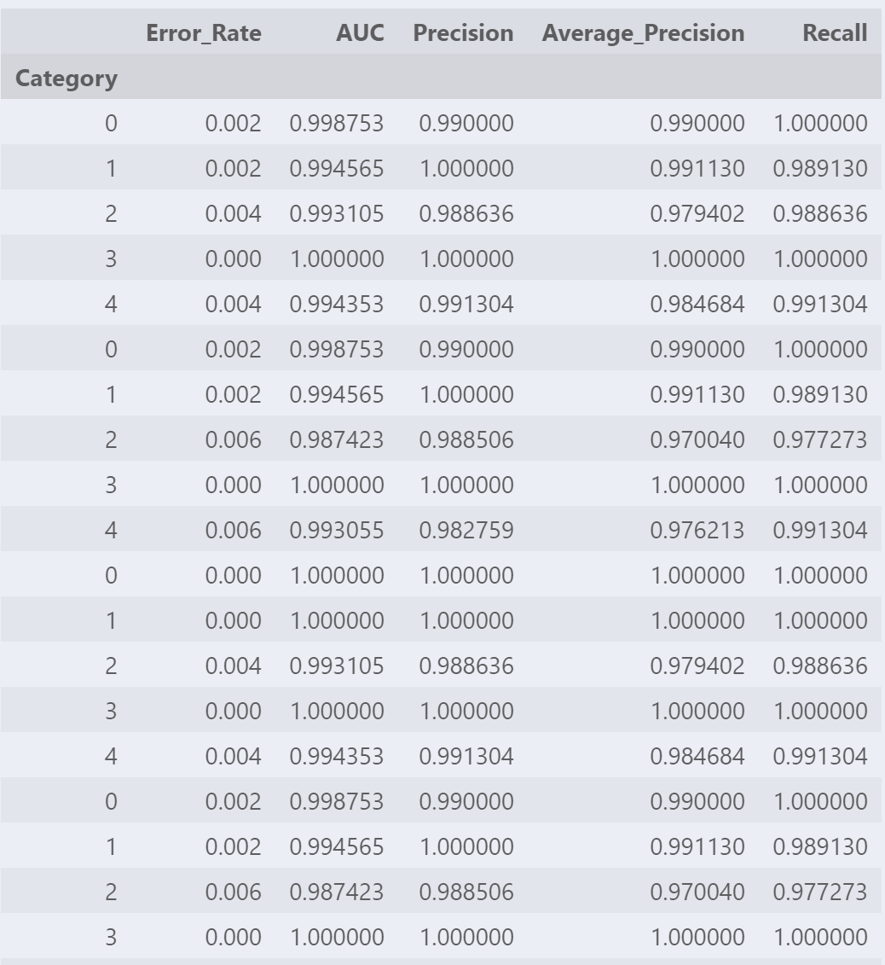
Another finding…Lifelong learner

Slide 6

The text
Tweets from 10 official accounts of news media, with 5 of them being left-skewed and 5 being right-skewed
5 Left skewed: CNN, Democracy Now, Daily Beast, Huffpost, and Jacobin
5 Right skewed: The American Spectator, Breitbart, Fox News, National Review, and New York Post Opinion.

Slide 7
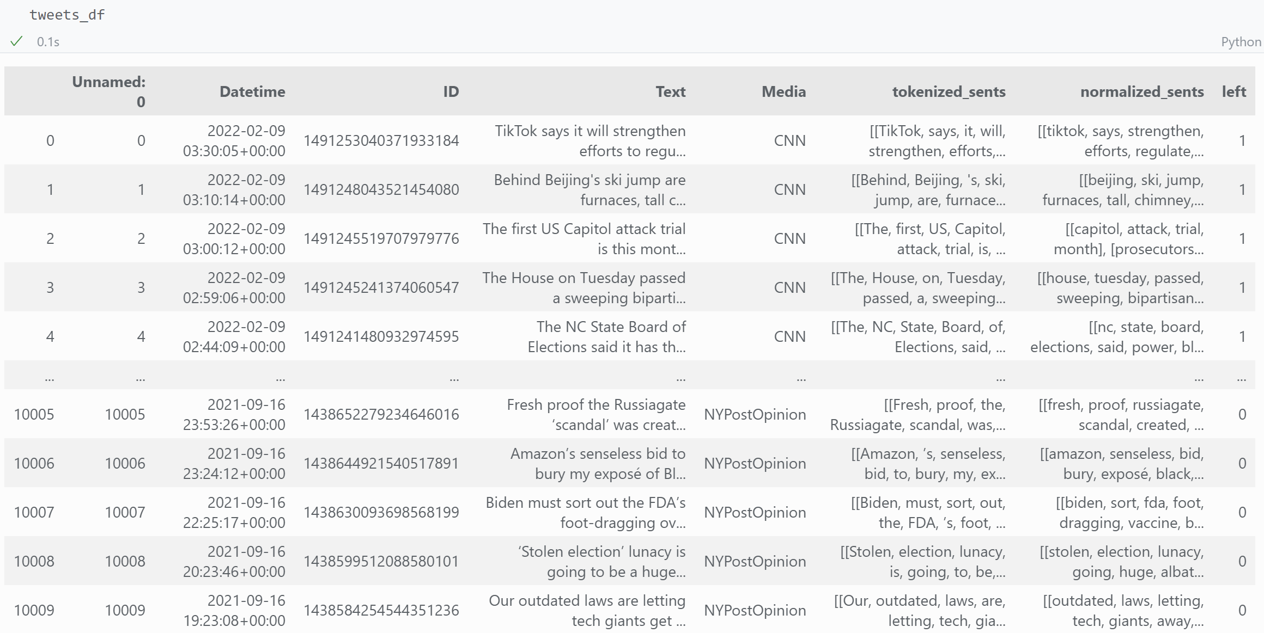
The data
Data: 1,000 tweets from each of the 10 media.
Task: Distinguishing between left- and right- skewed media

Slide 8
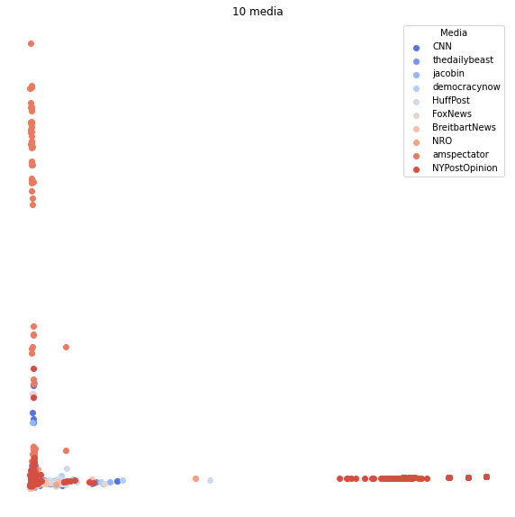
What PCA tells
TF-IDF + 2 dimentional PCA: failed to tell the two parties apart.

Slide 9
Logistic regression
1
2
3
4
 | 10 PCA components | 100 PCA components | 200 PCA components | with L1 regularization
Train Accuracy | 60.4% | 73.3% | 75.5% | 93.5%
Test Accuracy | 60.7% | 71.9% | 73.1% | 83.8%
The accuracy increases as more PCA components are added
The logistic regression with L1 regularization did an excellent job, though it shows a bit of overfitting.

Slide 10
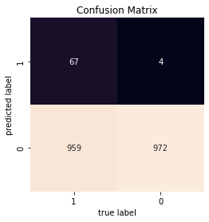
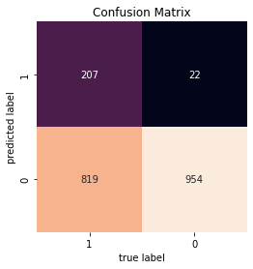
Decision Tree & Random Forest
Decision Tree
Random Forest

Slide 11
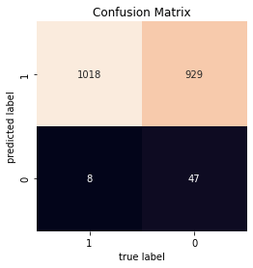
K Nearest Neighbor
Test Accuracy
Logistic regression with 10 components: 61%
Decision tree: 52%
Random forest: 58%
KNN: 53%

Slide 12
Neural Network
1
2
 | Logistic regression with L1 regularization | Neural network
Test Accuracy | 83.8% | 82.4%
Precision for the left | 79.8% | 81.6%
Precision for the right | 88.6% | 83.1%

Slide 13
Neural Network
1
2
 | Logistic regression with L1 regularization | Neural network
Test Accuracy | 83.8% | 82.4%
Precision for the left | 79.8% | 81.6%
Precision for the right | 88.6% | 83.1%

Slide 14
Whoa!
A classifier as simple as logistic regression can do a very good job on certain task.

Slide 15
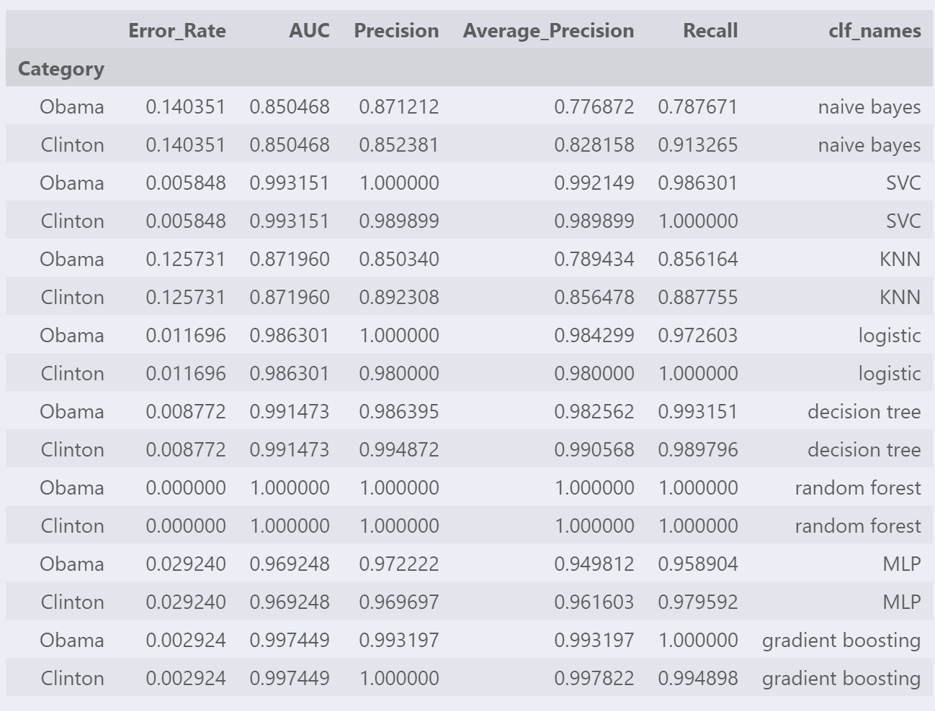
Senate press releases - small

Slide 16
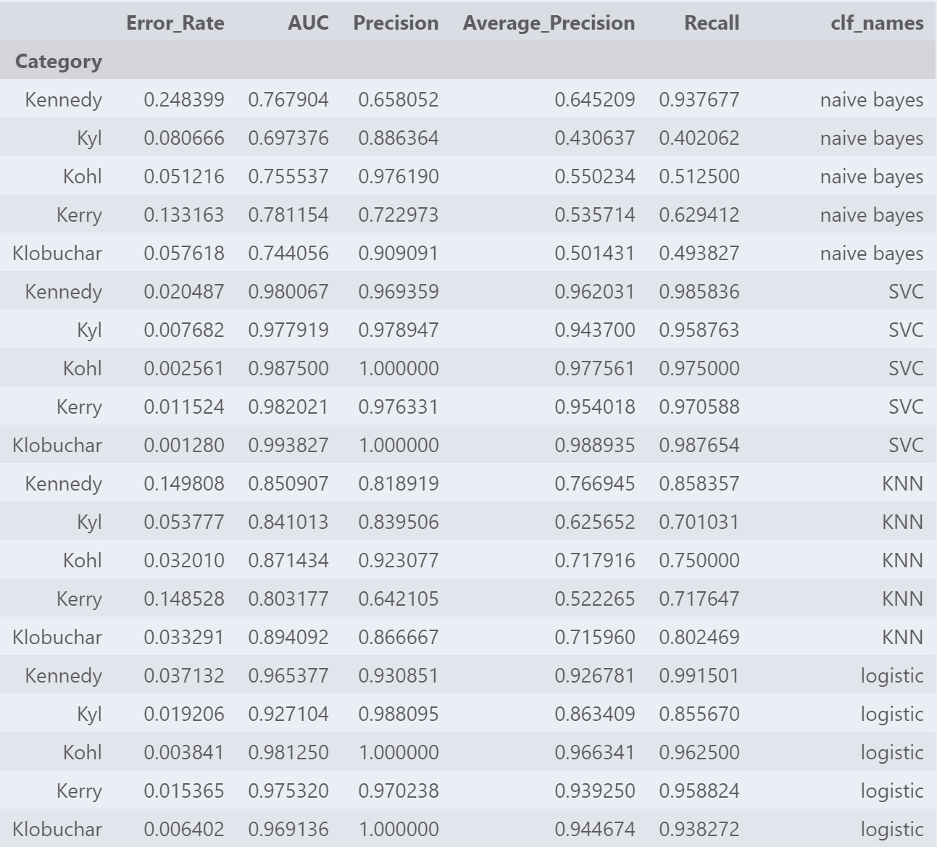
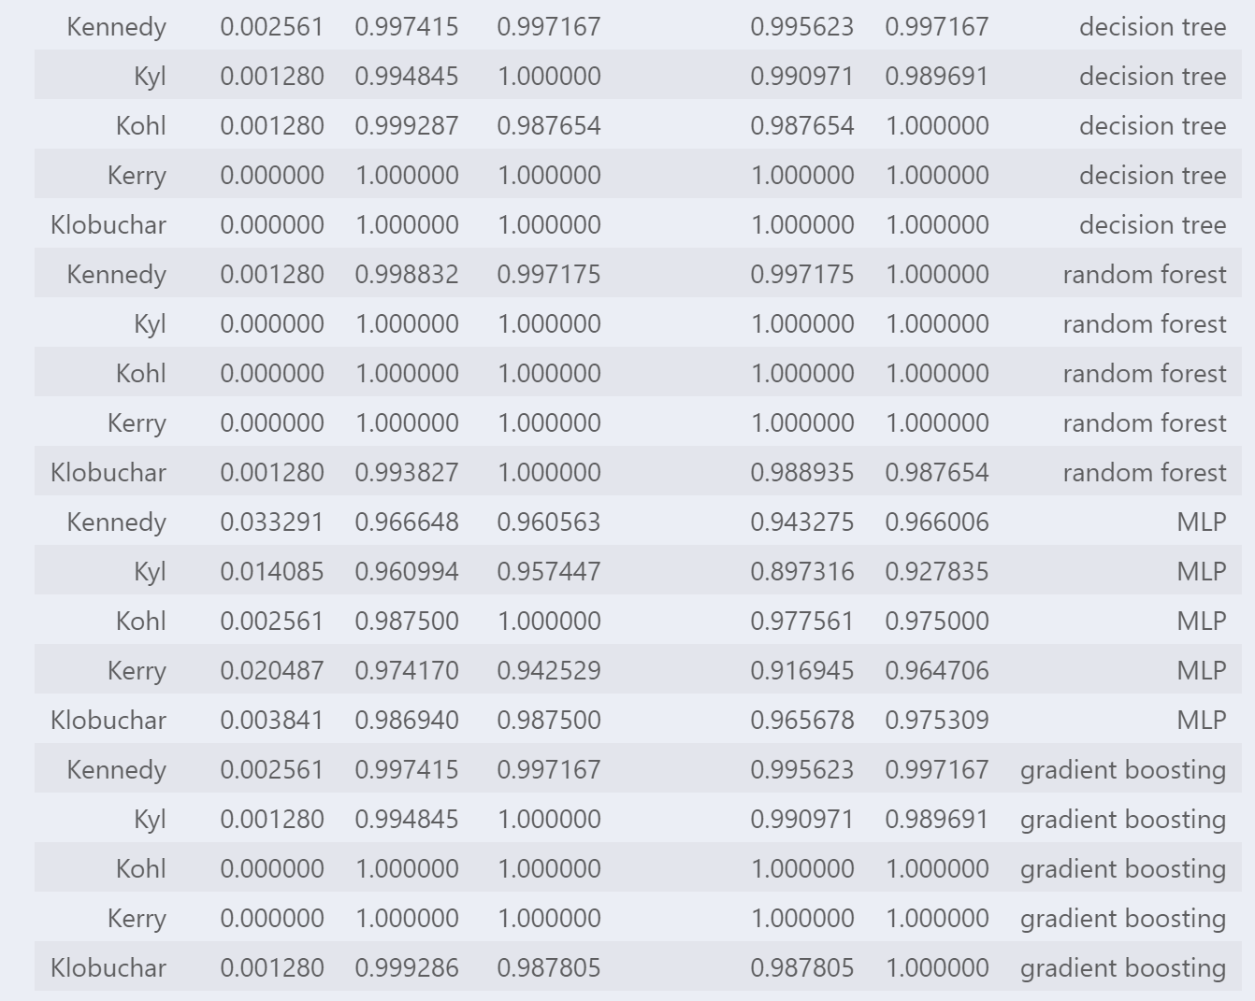
Senate press releases - large
Different classifiers seem to be good at identifying different senators

Slide 17
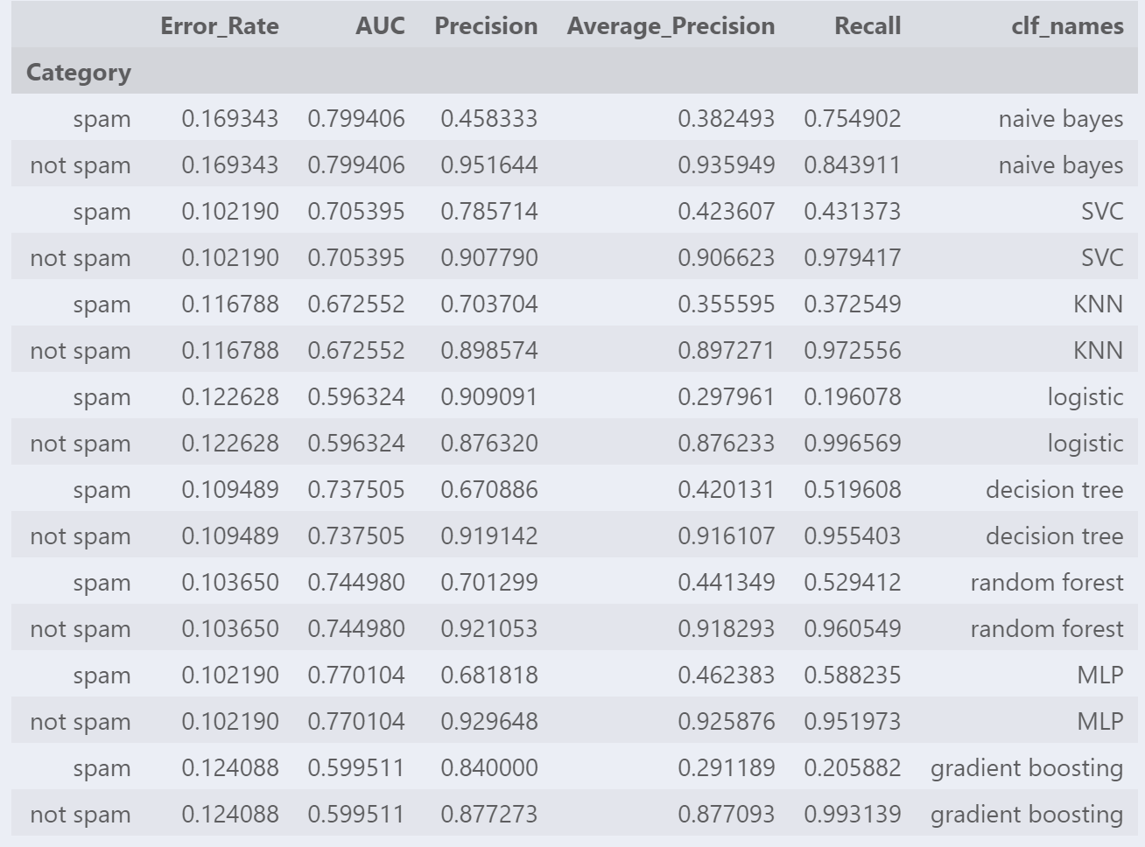
Spam

Slide 18

Spam
BERT
Sentiment analysis pipeline
Applied on my media tweets dataset

Slide 19
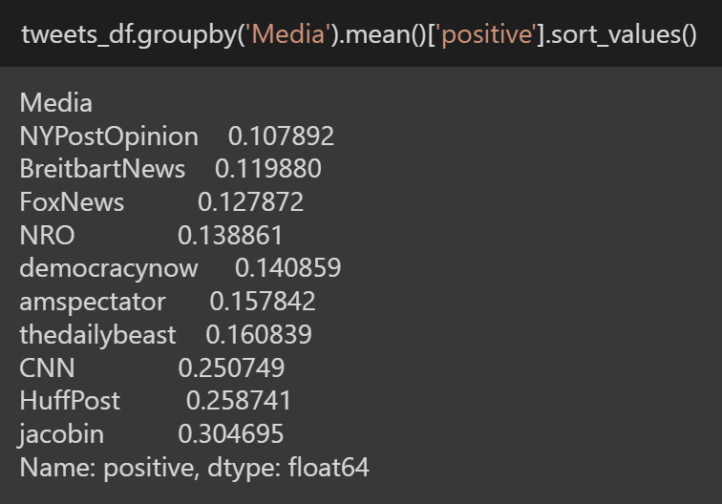
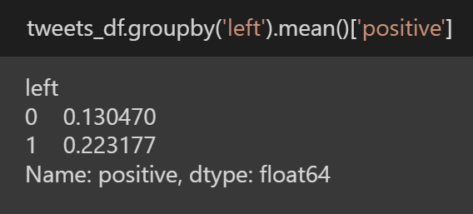
BERT - The “sentiment-analysis” pipeline
Calculated the average proportion of tweets with positive sentiment by skewness group, and by media

Slide 20
Takeaways
Different classifiers are good at different tasks.
The simple logistic regression classifier performs well on various tasks
Training for multiple times seems to boost the performance
But…How to open the black box?

